Slide 1
Mountains Circuit Review Answer the questions on a plain piece of paper.

Slide 2
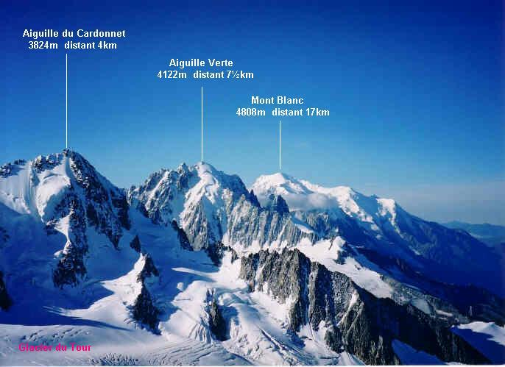
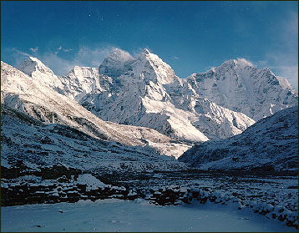
1. What kind of
mountains are these?
2. What type of stress
formed them?
ALPS
HIMALAYAS

Slide 3
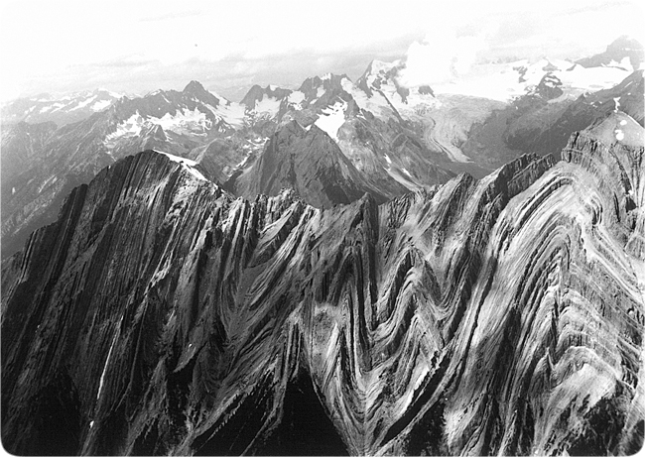
3. In folded mountains, the folds are _________ to the direction of the _____________.

Slide 4
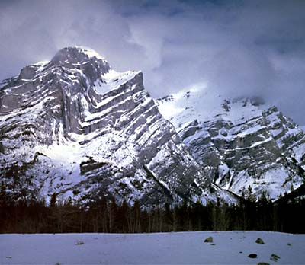
4. Which type of mountain forms with very little deformation?

Slide 5
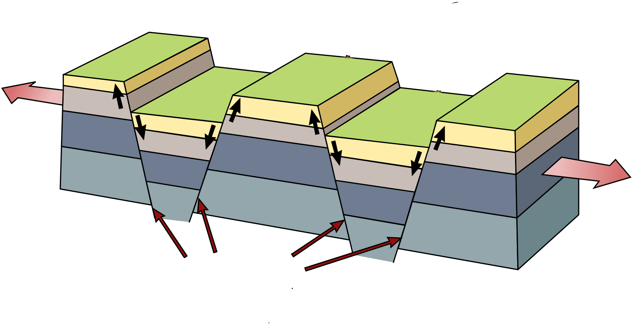
5. What type of mountain is formed this way? 6. What kind of faults formed at A?
A

